Slide 1
Pet Care Tracker
Illinois Institute of Technology
Dhanashri Panchputre
Front-End Web Development (ITMD-543)

Slide 2

Introduction
Project Overview
A pet care web application that allows users to add pet profiles, set reminders for various activities, and manage pet care tasks.
Key features: Adding pets, setting reminders, and displaying pet profiles on a dashboard.

Slide 3
Effective Use of HTML - Semantic Web Elements
Semantic HTML
The project uses semantic HTML elements like <form>, <input>, <button>, and <select> to structure the content meaningfully.
Example from add-pet.html
Best Practice: Use of labels and input fields ensures accessibility and improves the user experience by providing clear form structures.
<form id="pet-form">
<label for="pet-name">Pet Name:</label>
<input type="text" id="pet-name" name="pet-name" required>
<label for="breed">Breed:</label>
<input type="text" id="breed" name="breed" required>
<button type="submit">Add Pet</button>
</form>

Slide 4
Effective Use of HTML - Semantic Web Elements
Proper Use of Tags
Tags like <select> are used effectively in set-reminders.html to create dropdowns for selecting activities
<select id="activity-select">
<option value="vaccination">Vaccination</option>
<option value="vet-visit">Vet Visit</option>
<option value="grooming">Grooming</option>
</select>

Slide 5
Use of CSS to Deliver Proper User Experience
.pet-profile {
display: flex;
flex-direction: column;
align-items: center;
margin: 10px;
}
img {
width: 150px;
height: auto;
}
CSS for Layout & Styling
The project uses CSS to style forms, buttons, and layout components.
Example from styles.css
This provides a clean and visually appealing interface for users to interact with the pet profiles.

Slide 6
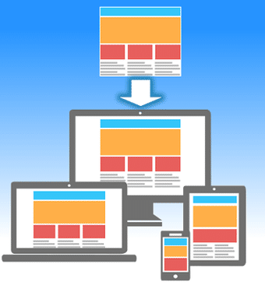
Use of CSS to Deliver Proper User Experience
Responsive Design:
Ensuring that the layout adapts to different screen sizes is crucial. It’s recommended to use media queries for responsiveness.
Best Practice: Use external stylesheets to separate content (HTML) from presentation (CSS), improving maintainability.

Slide 7
Use of JavaScript to Provide User Interactivity
JavaScript for Dynamic Features:
The script.js file handles dynamic interactions like adding pets and setting reminders.
Example of dynamically loading pets from local storage
let pets = JSON.parse(localStorage.getItem('pets')) || [];
function savePets() {
localStorage.setItem('pets', JSON.stringify(pets));
}

Slide 8
Use of JavaScript to Provide User Interactivity
DOM Manipulation
JavaScript is used to manipulate the DOM based on user actions. For instance, when a user adds a new pet, the profile is dynamically created and displayed on the dashboard.
Event Handling: Event listeners are used effectively to trigger actions based on user input.
document.addEventListener("DOMContentLoaded", function () {
const currentPage = getCurrentPage();
// Load pets or reminders based on the page
});

Slide 9
Use of JavaScript to Provide User Interactivity
Event Handling:
Event listeners are used effectively to trigger actions based on user input.
document.addEventListener("DOMContentLoaded", function () {
const currentPage = getCurrentPage();
// Load pets or reminders based on the page
});

Slide 10
Lessons Learned & Best Practices Recommendations
Semantic HTML
Always use semantic tags for better accessibility and SEO. This makes your code more readable and maintainable.
CSS Organization
Separate concerns by keeping your CSS in external files. Ensure proper use of classes and IDs for targeting elements.
JavaScript Best Practices
Keep your JavaScript modular by separating logic into functions. This improves code readability and maintainability.
Local Storage Usage
Using localStorage to persist data across sessions is a great way to enhance user experience without needing a backend.

Slide 11
Conclusion
The project demonstrates effective use of HTML, CSS, and JavaScript to create an interactive pet care application.
By following best practices in web development—such as using semantic elements, organizing CSS effectively, and leveraging JavaScript for interactivity—the application delivers a smooth user experience.

